Slide 1
Data Mining for Business
Week 4: Decision Trees Continued &
Model Evaluation
Dr. Kamesam

Slide 2
Decision Trees: A Summary
Decision tree is a classifier in the form of a tree structure
Decision trees classify instances (examples) by starting at the root of the tree, follow a path, and stopping at a leaf node.
Root: top of the tree with all the examples.
Decision node: specifies a test on a single attribute
Leaf node: No more splitting. Determines the class of the Target. Path: the path from the root to a Leaf node
All training examples must fall into one leaf node and only one
Tree built using a Recursive algorithm starting from the root
Pick a feature to split on (by Information Gain or Gini Index)
For a continuous valued attribute, pick where to split
After split, repeat splitting if necessary

Slide 3
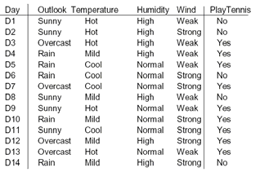
Classification with Discrete Attributes
Test
record
Sunny Hot Normal Strong ?
Outlook takes 3 values, Temperature 3, Humidity 2, and wind 2 possible values
All the Attributes are Categorical

Slide 4

Splitting on a Discrete Attribute

Slide 5

Entropy , Gini Index
Let S be a set of examples of c classes
Entropy, and Gini Index both measure the homogeneity of S
If c = 2, and p₁ and p₂ are the proportions of the two classes.
If S has c classes,
https://en.wikipedia.org/wiki/List_of_countries_by_income_equality

Slide 6




Entropy Calculation
Split on Outlook
9 YES 5 NO
= 0.9403
Sunny
Overcast
Rainy
2 YES 3 NO
4 YES 0 NO
3 YES 2 NO
0.9709
0
0.9709
Entropy after Split =
Information Gain = 0.9403 - 0.6935 = 0.2467

Slide 7





Gini Index Calculation
Split on Outlook
9 YES 5 NO
= 0.4592
Sunny
Overcast
Rainy
2 YES 3 NO
4 YES 0 NO
3 YES 2 NO
0.48
0
0.48
Improvement in Gini = 0.4592 - 0.3429 = 0.1163

Slide 8
Entropy or Gini Index
In SPSS Modeler,
C5.0 Decision Tree Learner uses Entropy.
C&RT Decision Tree Learner uses Gini Index

Slide 9


Selecting Attribute to Split
9 Yes
5 No
Information Gain
Gain(Outlook) = 0.247
Gain(Temperature) = 0.029
Gain(Humidity) = 0.152
Gain(Windy) = 0.048
All calculations in textbook
pp 100-101

Slide 10
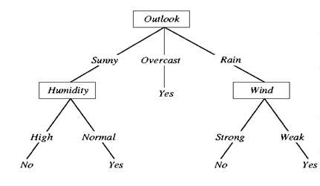
Decision Tree with Discrete attributes
(worked out example sec 4.3 of Witten book). Target: Yes, No

Slide 11










Classification with Continuous Attributes
Person | Hair Length | Weight | Age | Class
Homer | 0” | 250 | 36 | M
Marge | 10” | 150 | 34 | F
Bart | 2” | 90 | 10 | M
Lisa | 6” | 78 | 8 | F
Maggie | 4” | 20 | 1 | F
Abe | 1” | 170 | 70 | M
Selma | 8” | 160 | 41 | F
Otto | 10” | 180 | 38 | M
Krusty | 6” | 200 | 45 | M
Comic | 8” | 290 | 38 | ?

Slide 12
Discretization and deciding on split (Continuous Attributes)
Find each predictor’s best split. For each feature, find the best possible split for that field, as follows:
Weight from Simpson example. Although weight is a continuous attribute, the only values that apper in the training data are:
20, 78, 90, 150, 160, 170, 180, 200, 250
Try <= 49, >49, <= 84, >84, <= 120, >120 and so on.
Choose the split that gives the max information gain.
SPSS Modeler uses the above strategy

Slide 13
DT Search Strategy
Finding an optimal decision tree is NP-hard (which means it is very difficult)
The strategy of picking a split based on maximum information gain is only a heuristic
The algorithm presented for decision trees uses a greedy, top-down, recursive partitioning strategy to induce a reasonable, hopefully good solution

Slide 14
DTs in practice...
Growing to purity (i.e; growing the tree till every leaf node is pure) is bad (overfitting)
x2: sepal width
x1: petal length
Notes:
Train data(以上)

Slide 15
DTs in practice...
Growing to purity is bad (overfitting)
x2: sepal width
x1: petal length
Notes:
只有一个数据（元素）在某个class中，过拟合的标志

Slide 16
Overfitting and how to avoid
Growing to purity (all the examples in the node are of the same class) is bad (overfitting)
Results in poor accuracy for unseen samples
Test data set essential for evaluation
STRATEGIES
Pre Pruning: Terminate tree growth early
Post Pruning: Grow to purity, then prune back
Post Pruning is the most commonly used strategy, although there are many variations
16

Slide 17
DTs in practice...
Growing to purity is bad (overfitting)
Not statistically
supportable leaf
x2: sepal width
Remove split
& merge leaves
x1: petal length
17

Slide 18
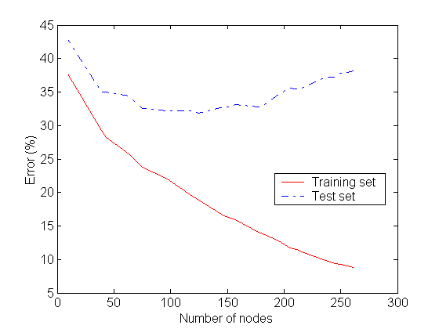
Underfitting and Overfitting
Overfitting
model complexity (the issue of overfitting is important for classification in general not only for decision trees)
Underfitting: when model is too simple, both training and test errors are large
Overfitting: Model is too complex, training errors may be small while test errors are large

Slide 19
Overfitting
Learning a tree that classifies the training data perfectly may not lead to the tree with the best generalization to unseen data.
There may be noise in the training data that the tree is erroneously fitting.
The algorithm may be making poor decisions towards the leaves of the tree that are based on very little data and may not reflect reliable trends.
on training data
on test data
accuracy
Model complexity/size of the tree (number of nodes)
Notes:
Overfitting （模型过于复杂）会降低模型实际的classify的能力（用test model测试时）

Slide 20
Overfitting Example
In electrical circuits, Ohm's law states that the current through a conductor between two points is directly proportional to the potential difference or voltage across the two points, and inversely proportional to the resistance between them.
Experimentally
measure 10 points
Fit a curve to the
Resulting data.
current (I)
voltage (V)
Perfect fit to training data with a 9th degree polynomial
(can fit any n points exactly with an n-1 degree polynomial)*
Notes:
* Y = a0 + a1x + a2x^2……

Slide 21
Example
Testing Ohms Law: V = IR (I = (1/R)V)
current (I)
voltage (V)
Better generalization with a linear function that fits training data less accurately than the polynomial → Better accuracy on Test Data

Slide 22
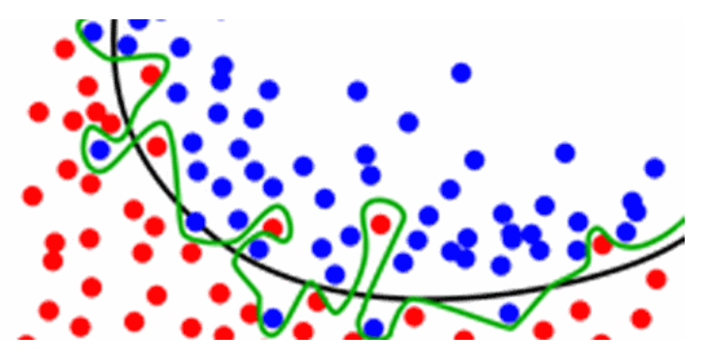
Ex 2: Over Fitting
Green curve: Over Fit to training data
Black curve: Much better choice

Slide 23
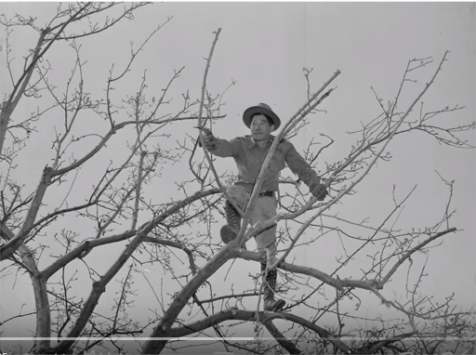
Avoid Overfitting : Pruning the Tree

Slide 24
Overfitting Prevention (Pruning) Methods in Decision Trees
Two basic approaches for decision trees
Pre pruning: Stop growing tree at some point during top-down construction when there is no longer sufficient data to make reliable decisions.
Post pruning: Grow the full tree, then remove subtrees that do not have sufficient evidence.
In Post pruning, Label leaf resulting from pruning with the majority class of the remaining data
Pre-pruning is difficult, because even though we may not get a good information gain at a node, further tree development could lead to significant gains

Slide 25
Training and Validation Set approach to avoid overfitting
Training Data Set:
used to create the Classifier
Validation Data Set(for pruning not test data):
used to evaluate the accuracy of the classifier over subsequent data
Used to evaluate and prune the Decision Tree
Philosophy: (fine tune the model)
Prevent over-fitting
Test Data set: Must still keep a test data set, unseen by the classification algorithm

Slide 26
Validation Data set
Validation data provides a safety check against overfitting spurious characteristics of data
Needs to be large enough to provide a statistically significant sample of instances
Typically validation set is 1/3 to 1/2 of training data set
MODEL BUILDING
Evaluation
VALID ATION
TRAINING
TEST
TRAINING
VALIDATION
Notes:
40 training 30 validation 30test

Slide 27
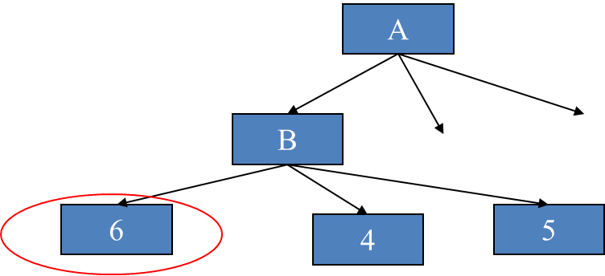
Post Pruning Example
Pruning is done using the Validation dataset
Tree is built with training data
Will be tested with Test data, after Pruning
After pruning
Leaf nodes 1,2,3
Tree Before Pruning
A
B
C
4
5
1
2
3

Slide 28
How to use validation set to Prune
Consider each decision node in the tree to be a candidates for pruning
Pruning a decision tree consists of
removing a sub-tree rooted at the node
making it a leaf node
assigning it the most common classification of the training examples affiliated with that node.
Reduced Error Pruning: Nodes are removed only if the resulting pruned tree performs no worse than the original over the validation set.

Slide 29
Decision Trees Summary
Advantages: Decision Trees are popular because they are easy to understand, explain, or use.
Disadvantages:
They are prone to overfitting.
Not suitable for streaming data
Decision forests: are a generalization of decision trees, where a number of decision trees together form a decision forest. The decision forest serves as the classifier
Decision forests correct for decision trees' weakness of overfitting to their training set
A number of studies have shown that Decision Forests perform better than Decision Trees

Slide 30
Can we start using the model?

Slide 31
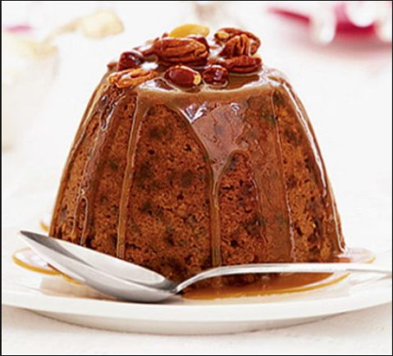
How Good is the Classifier (Model)?
“The proof of
the pudding is
in the eating”
To fully judge how effective something is, you need to use it for its intended purpose.

Slide 32
Model Evaluation
Metrics for Performance Evaluation
Model Accuracy on Test Set, NOT training set
Of all the test examples, how many were accurately classified by the model?
Incidence Matrix (also called Confusion Matrix)
You can see correct classifications, and misclassifications by each class

Slide 33
Metrics for Performance Evaluation
Focus on the predictive capability of a model
Rather than how fast it takes to classify or build models, scalability, etc.
Confusion Matrix:
 | PREDICTED CLASS
ACTUAL CLASS |  | Class=Yes | Class=No
 | Class=Yes | a | b
 | Class=No | c | d
a: TP (true positive)
b: FN (false negative)
c: FP (false positive)
d: TN (true negative)

Slide 34
Metrics for Performance Evaluation…
 | PREDICTED CLASS
ACTUAL CLASS |  | Class=P | Class=N
 | Class=P | a (TP) | b (FN)
 | Class=N | c (FP) | d (TN)
Again, Remember: We are concerned about accuracy on “UNSEEN” data and NOT the training data
Error Rate = 1 - Accuracy

Slide 35
Limitation of Accuracy Measure
Consider an extreme example ( 2-classes)
Number of Class 0 examples = 9900
Number of Class 1 examples = 100
If model predicts everything to be class 0, accuracy is 9900/10000 = 99.0 %
Accuracy can be misleading because model does not detect any class 1 example
Often, important to pay attention to minority class

Slide 36
Costs of Decisions Matter
The error rate (or Accuracy rate) is an inadequate measure of the performance of an algorithm, it doesn’t take into account the cost of making wrong decisions.
Example: Based on chemical analysis of the water try to detect an oil slick in the sea.
False positive: wrongly identifying an oil slick when there is none.
False negative: fail to identify an oil slick if there is one.
Here, false negatives (environmental disasters) are much more costly than false positives (false alarms). We have to take that into account when we evaluate our model.

Slide 37
Ex: Comparing 3 classifiers
True | Predicted
 | pos | neg
pos | 40 | 60
neg | 30 | 70
True | Predicted
 | pos | neg
pos | 70 | 30
neg | 50 | 50
True | Predicted
 | pos | neg
pos | 60 | 40
neg | 20 | 80
Classifier 1
TP = 0.4
FP = 0.3
Classifier 2
TP = 0.7
FP = 0.5
Classifier 3
TP = 0.6
FP = 0.2

Slide 38
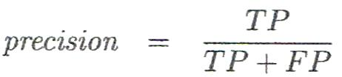
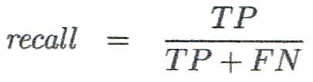
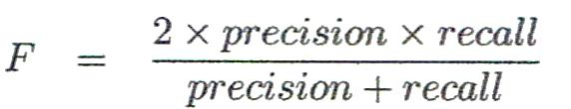
Other Classifier Evaluation Metrics
Precision
% of instances that the classifier predicted as positive that are actually positive
Recall
% of positive instances that the classifier predicted correctly as positive
a.k.a “Completeness”
Perfect score for both is 1.0, but there is often a trade-off between Precision and Recall
F measure (F₁ or F-score)
harmonic mean of precision and recall

Slide 39
Recall: Of all the + examples in the test data, how many are predicted + Precision: Of all the test data predicted +, how many are actually +
= TRUE positive Rate
 | PREDICTED CLASS
ACTUAL CLASS |  | Class= + | Class= -
 | Class= + | a (TP) | b (FN)
 | Class= - | c (FP) | d (TN)
a/(a+b) = TP Rate
c/(c+d) = FP Rate

Slide 40
Precision and Recall
Notes:
Recall = 407/500, Precision = 407/515, accuracy = 567/768

Slide 41
K Fold Cross Validation
Another Popular Method for Testing a model’s Performance

Slide 42
When a searchengine returns 30 pages only 20 of which were relevant while failing to return 40 additional relevant pages,itsprecisionis20/30=2/3whileitsrecallis20/60=1/3.So,inthiscase,precisionis"howusefulthesearchresultsare",andrecallis"howcompletetheresultsare".
Computer program for recognizingdogsinscenesfromavideoidentifies7dogsinascenecontaining9dogsandsomecats.If4oftheidentificationsarecorrect,but3areactuallycats,theprogram'sprecisionis4/7whileitsrecallis4/9.

Slide 43
Cross‐validation
Sec 5.3 of Textbook
Cross‐validation
Stratified cross‐validation
Source: Ian Witten

Slide 44
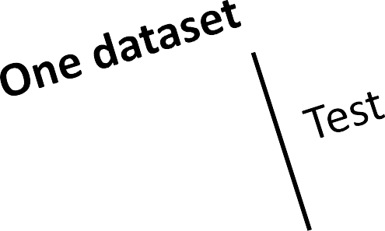

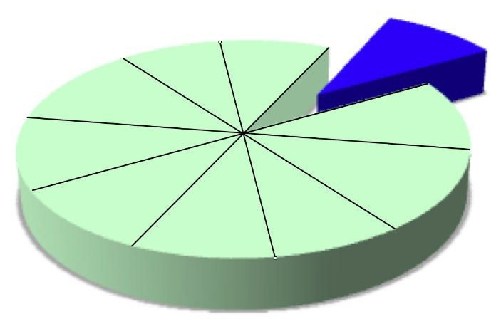
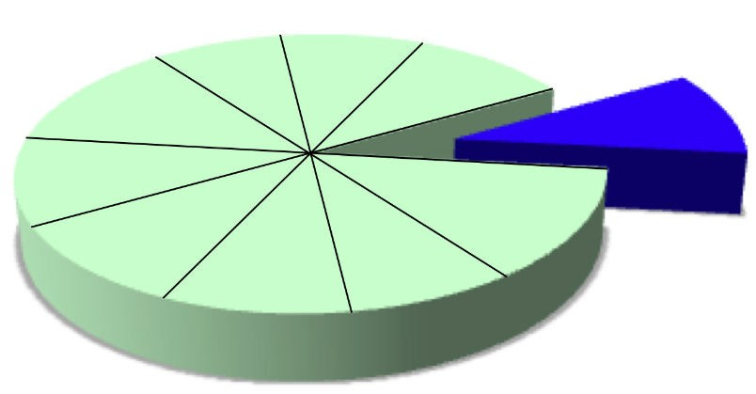
Cross‐validation
Repeated holdout
( hold out 10% for testing, repeat 10 times)
(repeat 10 times)
Source: Ian Witten

Slide 45
Cross‐validation
10‐fold cross‐validation
Divide dataset into 10 parts (folds)
Hold out each part in turn
Average the results
Each data point used once for testing, 9 times for training
Stratified cross‐validation
Ensure that each fold has the right proportion of each class value
Source: Ian Witten

Slide 46
Cross‐validation
After cross‐validation, Weka outputs an extra model built on the entire dataset
10% of data
90% of data
ML
algorithm
Classifier
10 times
Evaluation results
11th time
100% of data
ML
algorithm
Classifier
Deploy!

Slide 47
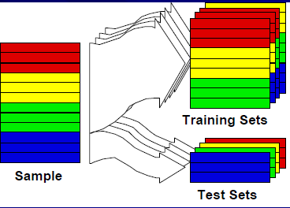
Holdout validation: Cross-validation (CV)
Partition data into k “folds” (randomly)
Run training/test evaluation k times

Slide 48
Validation Data Set
Repetition of previous slide
Provides a safety check against overfitting spurious characteristics of data
Needs to be large enough to provide a statistically significant sample of instances
Typically validation set is 1/3 to 1/2 of training set

